Slide 1

National Chemical Laboratory
CSR Project PROPOSAL/CONCEPT NOTE
Contact:
Dr. Pradip Maity;
Dr. K Krishnamoorthy
Scientist
E-mail: p.maity@ncl.res.in; k.krishnamoorthy@ncl.res.in
Contact No: +91-20-2590-2420/3075
Website: www.ncl-india.org
CSIR-National Chemical Laboratory, Dr. Homi Bhabha Road, Pune-411008, Maharashtra, India

Slide 2

N-Heterocyclic Liquid Hydrogen Organic Carrier (LOHC) for hydrogen generation at room temperature
Project Proposal for CSR Fund
Brief Problem Statement:
A light/electrochemistry mediated process to generate hydrogen from N-heterocyclic LOHC (LOHC+)
The current thermodynamic and kinetic energy requirements are not economically competitive. N-heterocyclic LOHC satisfy the thermodynamics and low temperature hydrogen generation (dehydrogenation) would improve the kinetics.
Hydrogen is recognized internationally as green energy source and projected to replace carbon based fuel.
Objectives:
Light/electrochemical dehydrogenation of N-heterocyclic LOHC (proof-of-concept achieved)
Screening other LOHC candidates and catalysts to optimize
Scale-up with the optimal LOHC
Heterogenization of the catalyst systems
CSIR-NCL is dedicated to utilize the CSR funds with themes aligned with Sustainable Development Goals set by UN

Slide 3

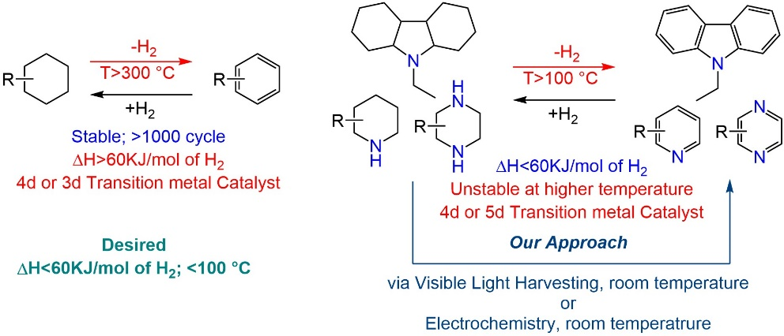
Problem Statement
Problem Statement
Use Pictures, Numbers, and illustrate the issue

Slide 4












What can WE do?
CSR Project Proposal: Activity Details
What is the Activity Planned?
SMART Goals
Specific LOHC with >5wt% H2, <60 KJ/mol of H2, <10KW/H/Kg for H2 generation
Measurable Thermodynamic and kinetic energy requirements
Achievable using N-heterocyclic LOHC and suitable catalysts system to achieve H2 generation at low temp.
Realistic at room temperature H2 generation
Timely Proof-of-concept and demonstration
Lab scale proof-of-concept achieved
Screening of LOHC and catalyst combinations
Light vs electrochemical or combination
Heterogeneous catalyst development
Scale-up: Batch and Flow
What would be the impact of undertaking this activity?
Examples:
Support for the creation of infrastructure
Creation of a specialized facility of wider utility
Support for technology driven projects
Support for projects in futuristic technology areas
Support for a Centre of Excellence
Research Fellowships

