Slide 1

National Chemical Laboratory
CSR Project PROPOSAL/CONCEPT NOTE
Contact:
Dr. Pradip Maity;
Scientist
E-mail: p.maity@ncl.res.in; Contact No: +91-20-2590-2420
Website: www.ncl-india.org
CSIR-National Chemical Laboratory, Dr. Homi Bhabha Road, Pune-411008, Maharashtra, India

Slide 2

Synthetic process for Cyclohexanone Oxime from Cyclohexane via Photo-catalysis
Project Proposal for CSR Fund
Brief Problem Statement:
A visible light photocatalytic flow synthesis of cyclohexanone oxime from cyclohexanone.
cyclohexanone oxime is a bulk scale fine chemical for nylon-6 synthesis. It is industrially prepared from cyclohexanone. Cyclohexanone is synthesized from cyclohexane. A direct synthesis from cyclohexane would simplify the process and avoid the drawbacks of each stepwise processes.
Nylon 6 (polyamide 6) is an important construction material for many industries including automotive, aircraft, electronic, clothing, and medicine industry. A greener and economical alternative would be beneficial.
Objectives:
Synthesis of cyclohexanone oxime directly from cylohexane
Develop a photo-flow process
Scale-up the photo-flow process
CSIR-NCL is dedicated to utilize the CSR funds with themes aligned with Sustainable Development Goals set by UN

Slide 3

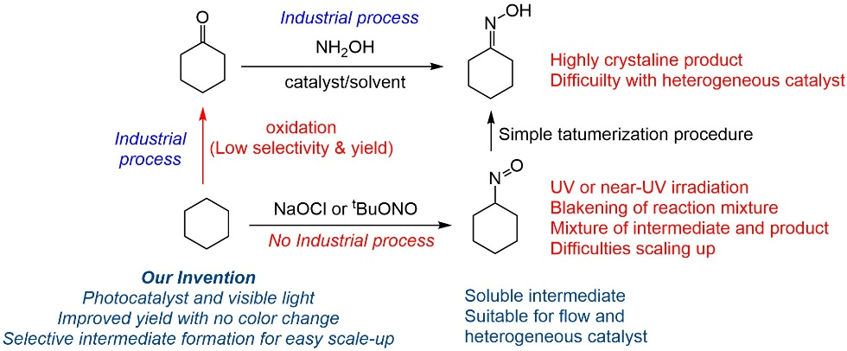
Problem Statement
Problem Statement
Use Pictures, Numbers, and illustrate the issue

Slide 4












What can WE do?
CSR Project Proposal: Activity Details
What is the Activity Planned?
SMART Goals
Specific Process for cyclohexanone oxime from cyclohexane
Measurable Scalability, comparison with established two-step industrial method
Achievable via visible light harvesting
Realistic avoid using UV or near-UV light
Timely easy to scale up for comparisn
Lab scale proof-of-concept achieved
Optimization to avoid product crystallization
Development of photo-flow process
Scale-up: Batch and Flow
What would be the impact of undertaking this activity?
Examples:
Support for the creation of infrastructure
Creation of a specialized facility of wider utility
Support for technology driven projects
Support for projects in futuristic technology areas
Support for a Centre of Excellence
Research Fellowships

